Slide 1
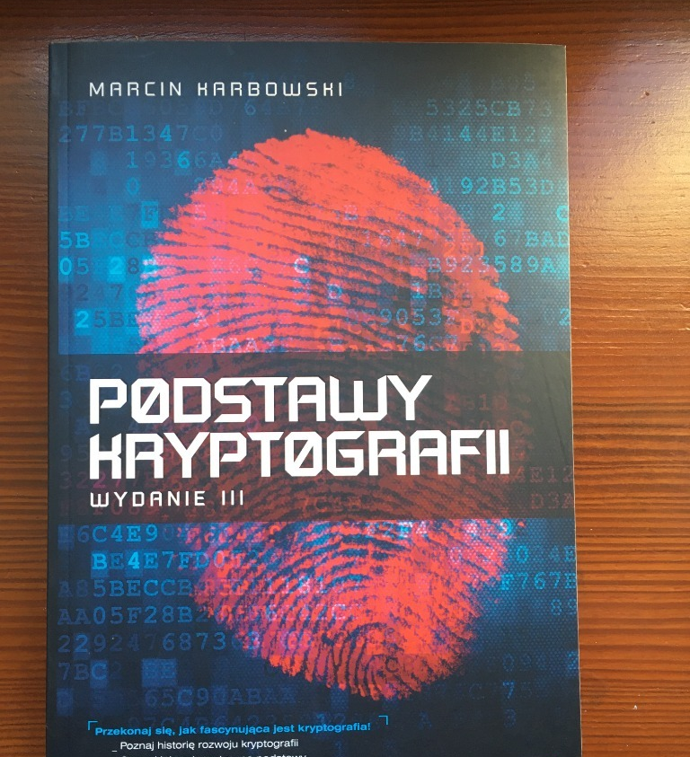

Basics of Cryptography 1. History

Slide 2
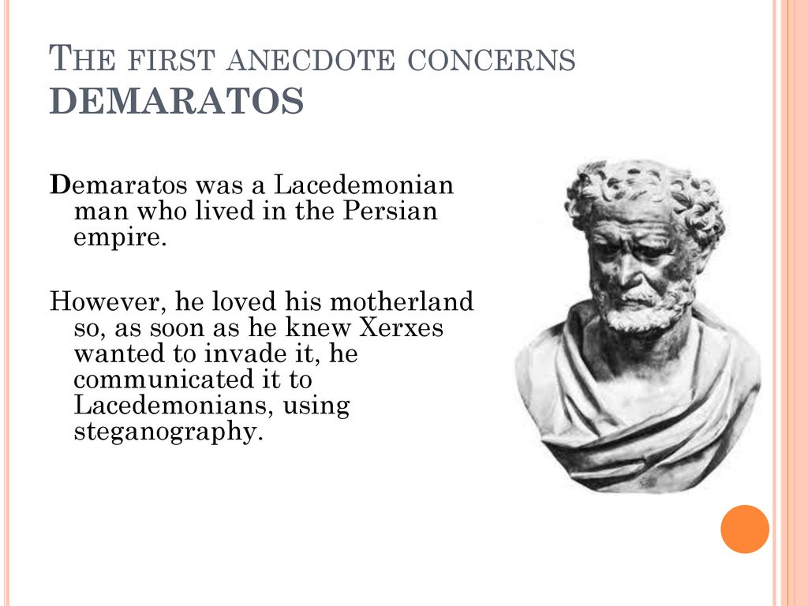
Stenography
And the message hidden in the ".".

Slide 3
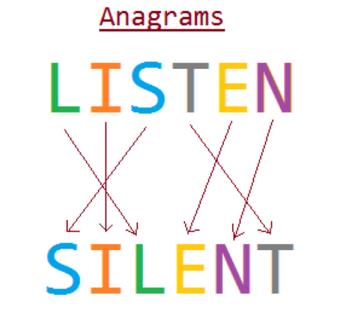
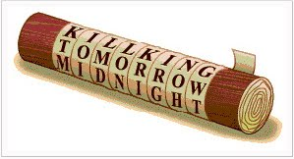
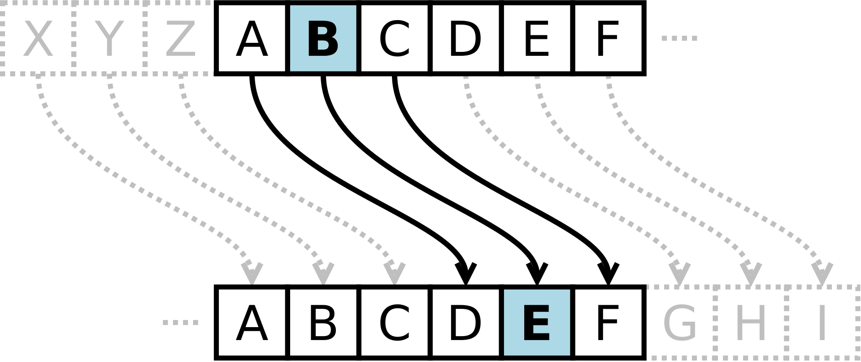
Cryptography
Its about hiding the CONTENT of the message
In ancient times it contained of:
.shifting and/or
.substituing
Scytale
Cesar's and key distribution problem

Slide 4

Cryptoanalisis
Al Kindy and the end of MONOALPHABETIC ciphers.
Chosen Plain-Text Attack.
Scytale
If you know the base language of the cipher (eg. German) you need to take a page long plain text in that language and count letters from the most to the least appearing. Then do the same with secret text. Then substitue correspondencies

Slide 5
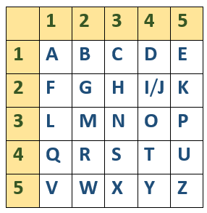
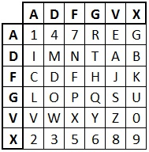
Importance of Cryptoanalysis
Polybius Table, 200 BC
How French broke unknown code, saved Paris and won 1st WW
Table used by Germans, 1st WW
XAXFX AGFDXXA DXGGX FAFFA XGAGX AVDFA GAXFX

Slide 6
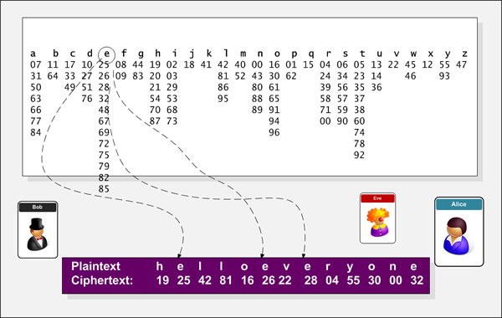
Further development of cryptography
Homofonic Cipher
XVI / XVII century

Slide 7
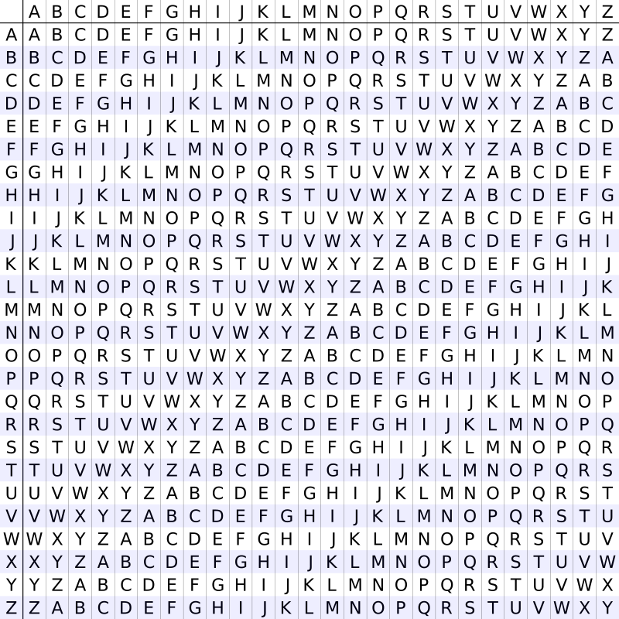
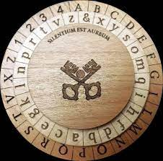
Polyalphabetic Ciphers
Alberti's shield
Tabula Recta and Vinegret's Cipher

Slide 8
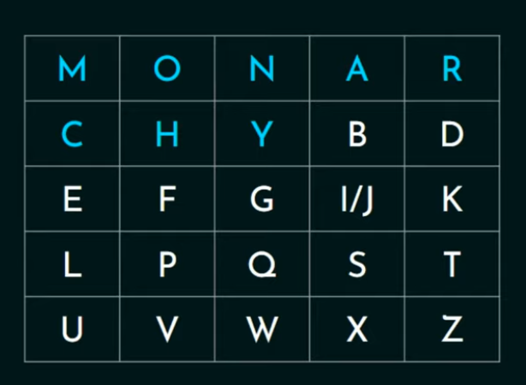
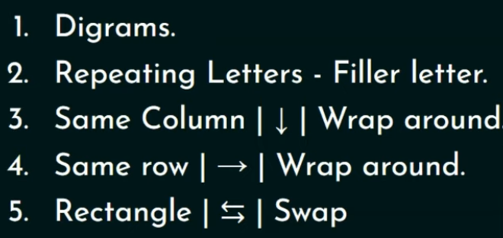
Diagraph Ciphers
Called also: Playfair
Keyword: Monarchy
Rules

Slide 9
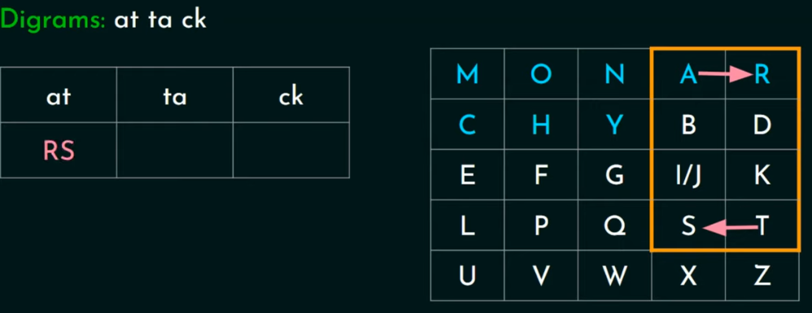
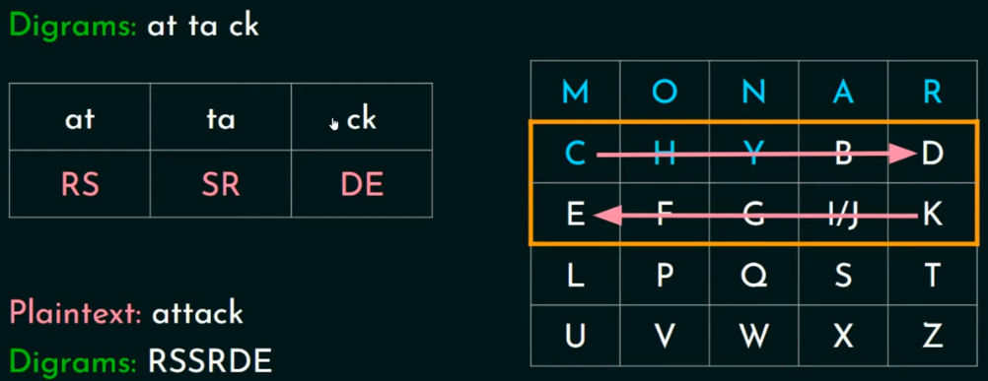
Diagraph Ciphers

Slide 10
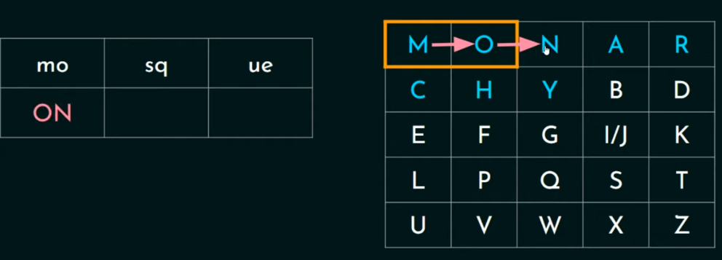
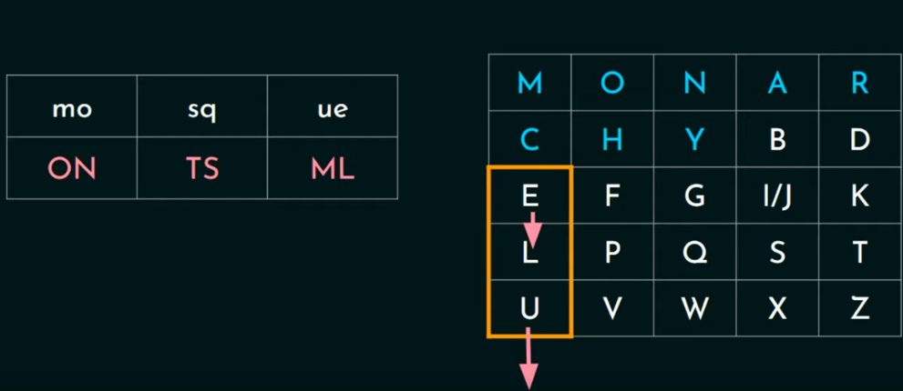
Diagraph Ciphers

Slide 11
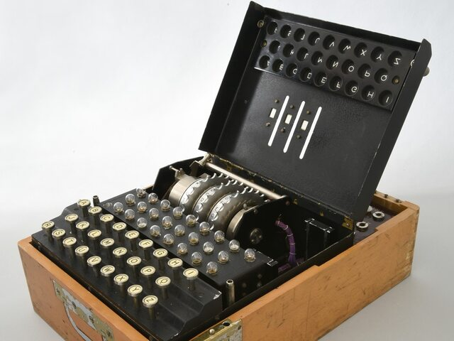
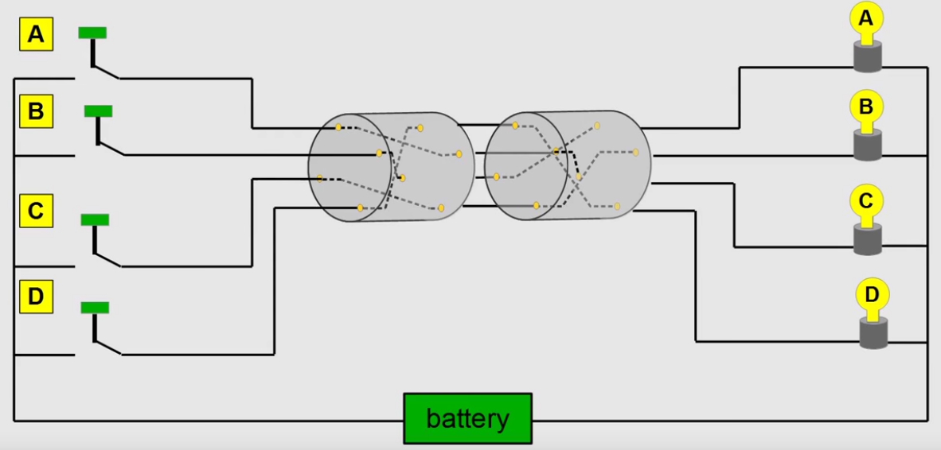
II WW
Enigma

Slide 12
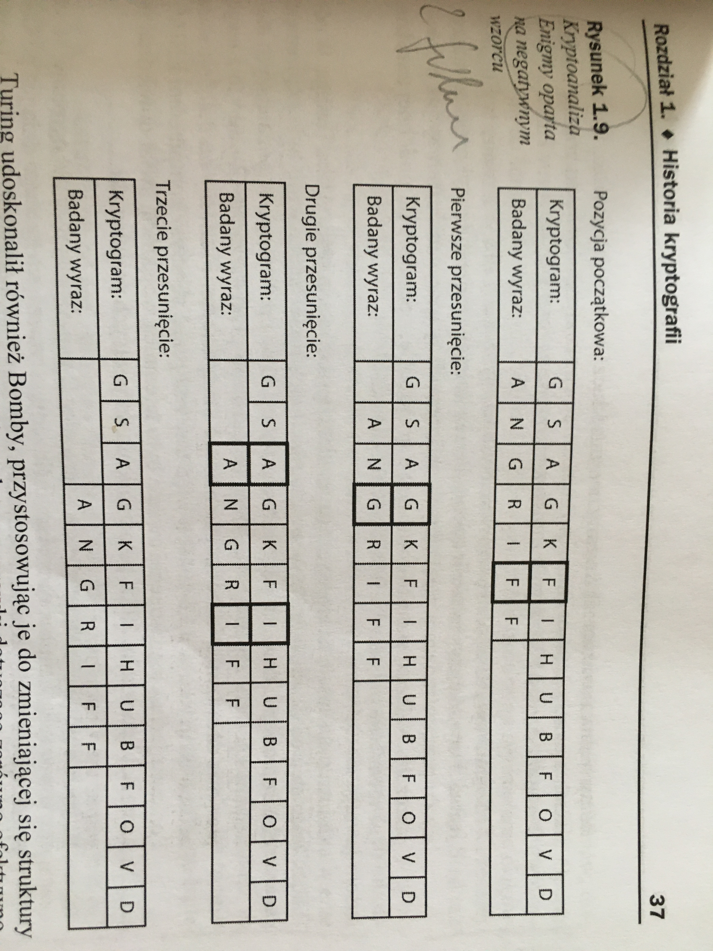
II WW
Enigma – how was it uncoded?

Slide 13
2000
Symmetric Cryptography
DES
Legislation battle about strong standards.
Asymetric Cryptography
RSA
Public and private key
Digital Signatures
Factorization of prime numbers

Slide 14
Basics of Cryptography 2. Future

Slide 15
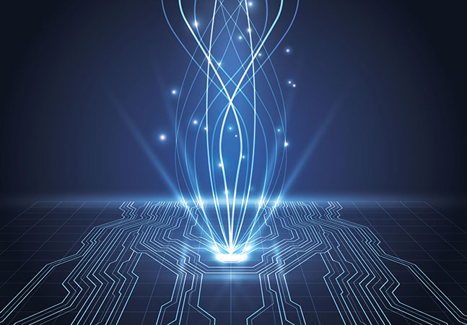
Quantum Cryptography
Quantum Computers

Slide 16
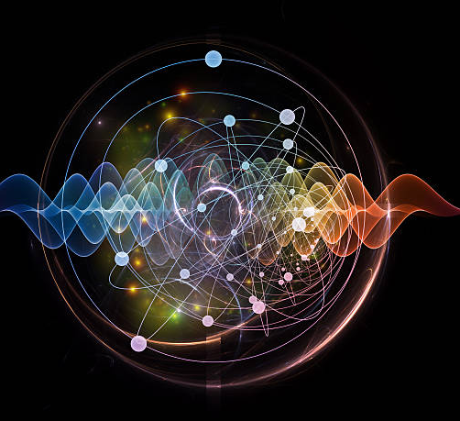
What is Quantum?

Slide 17
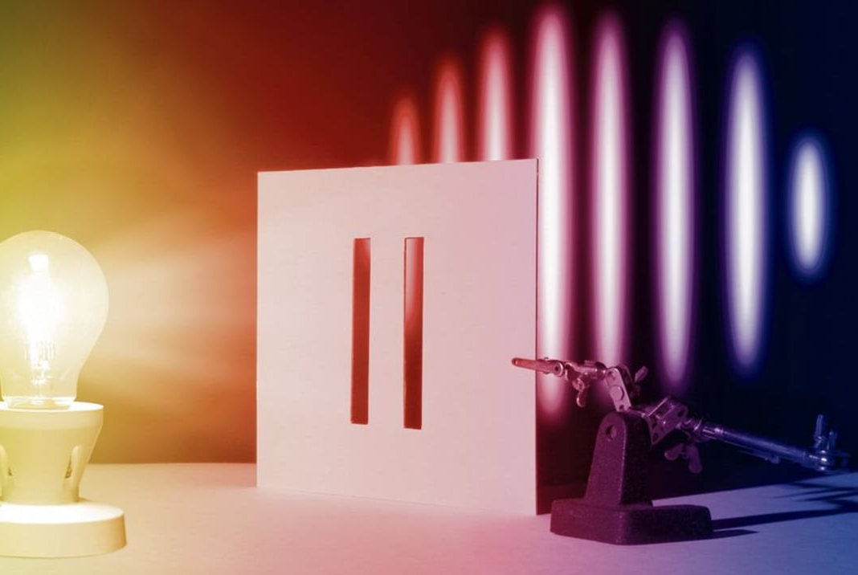
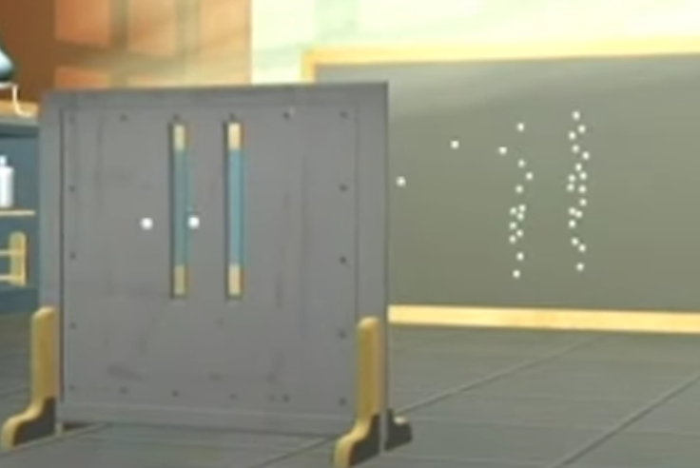
Corpus-Wave Dualism
Heisenberg's Uncertainty Principle

Slide 18
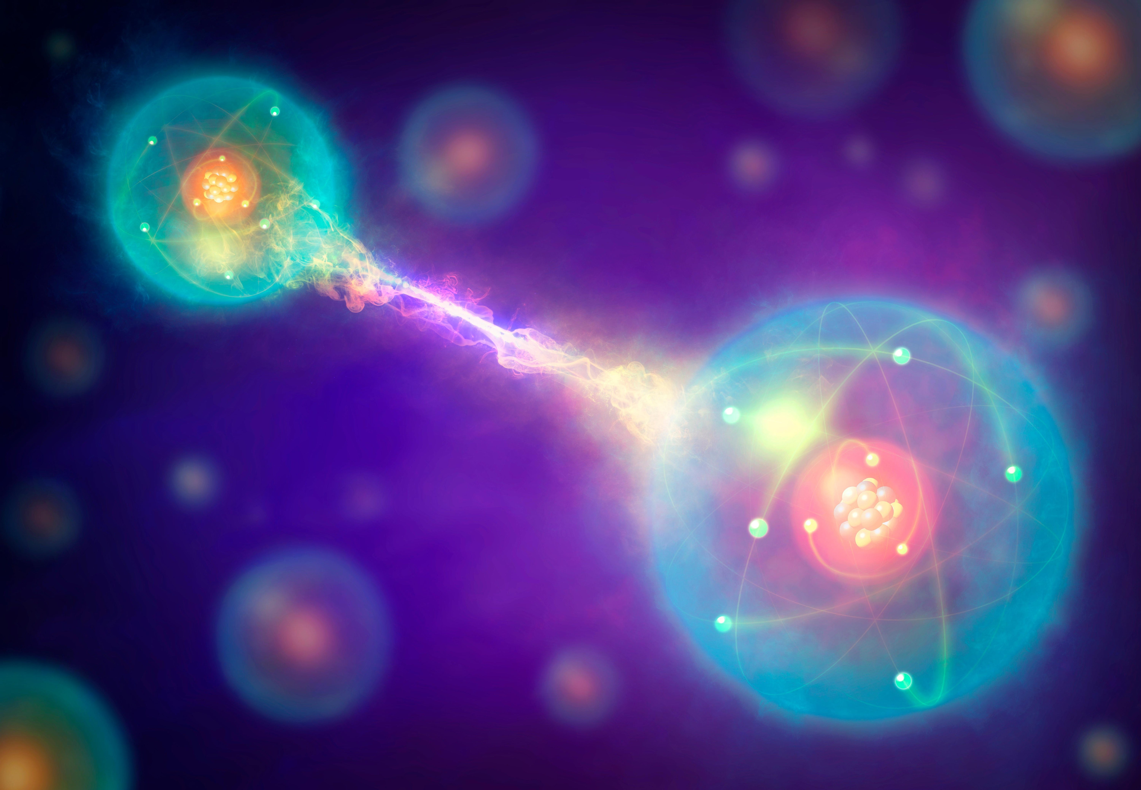
Quantum Entanglement

Slide 19
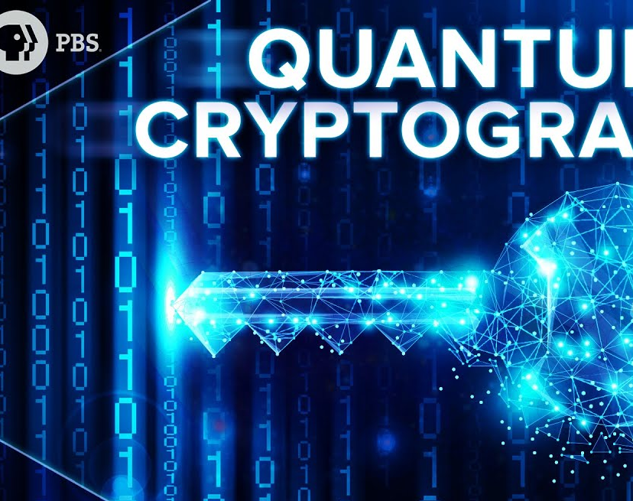
Quantum Cryptography

Slide 20
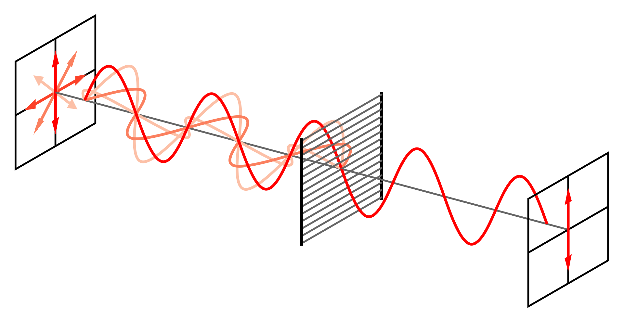
Polarisation of a particle
A photon can be polarized in any direction. The only way to verify it is to use polarizator. When passing through it photon decides about its state. Knowing this principle we can use it for quantum cryptography.

Slide 21
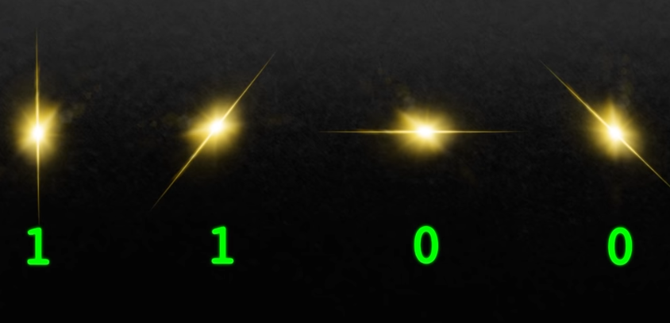
Meaning

Slide 22
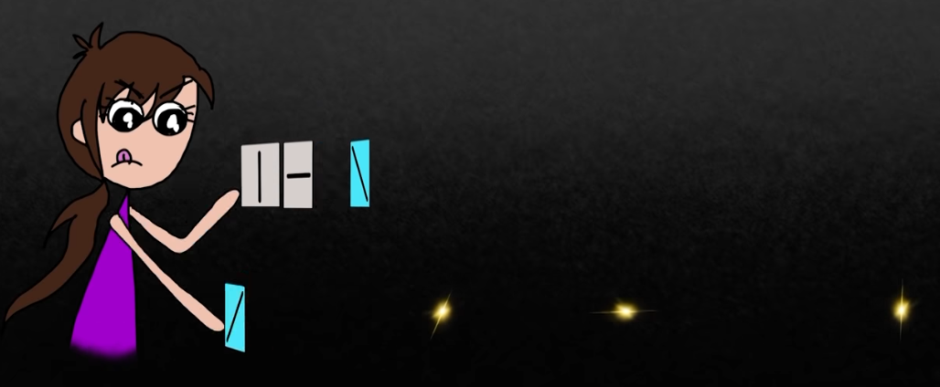

Slide 23
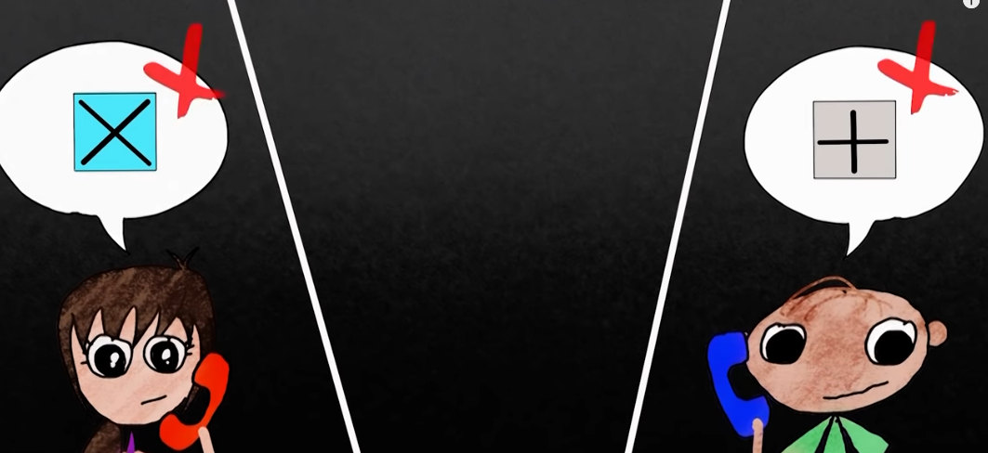

Slide 24
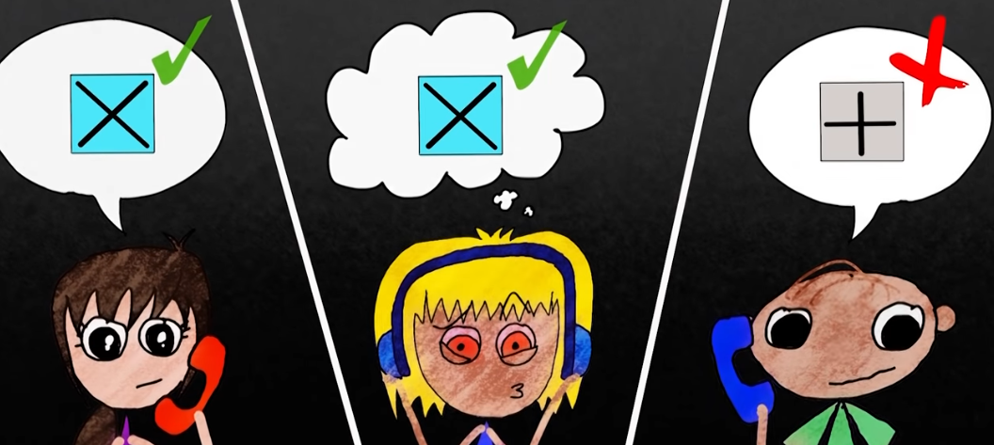

Slide 25
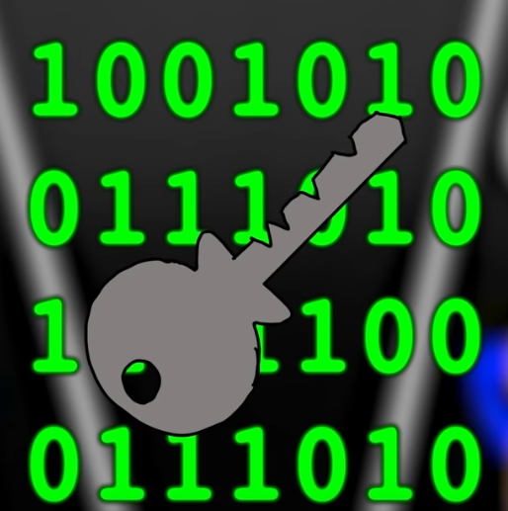
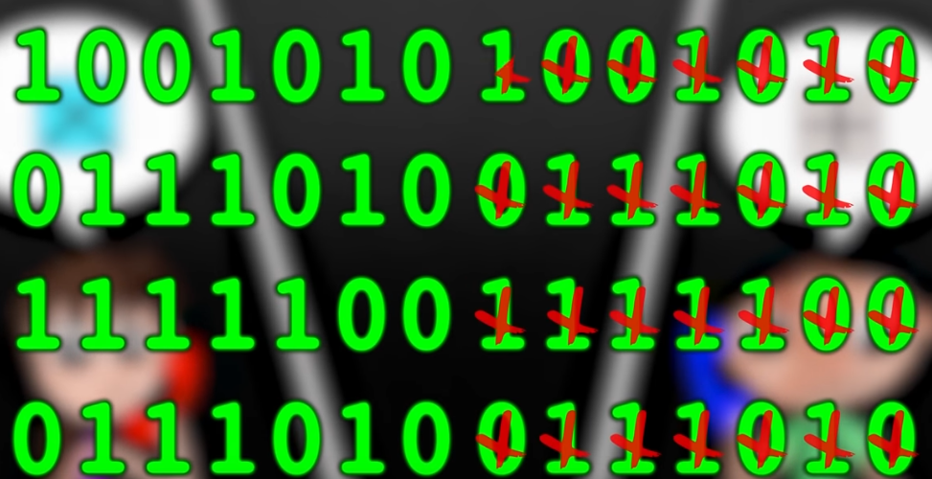

Slide 26
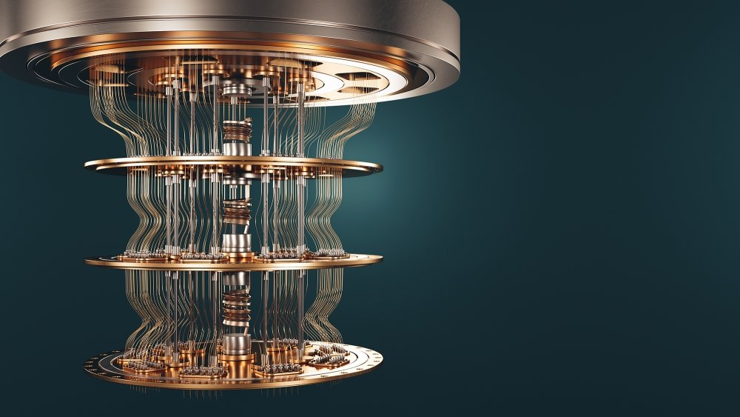
Quantum Computers

Slide 27
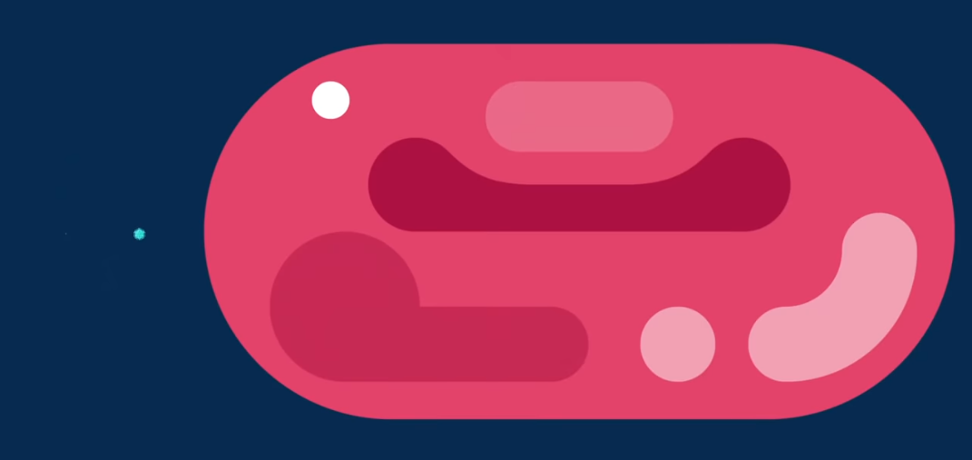


Transistor vs HIV Virus vs Red Blood Cell

Slide 28

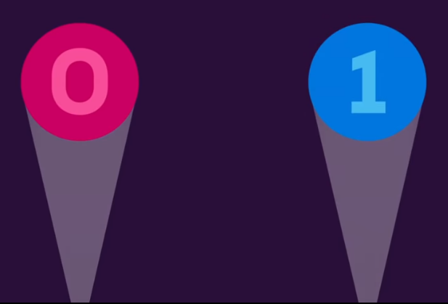
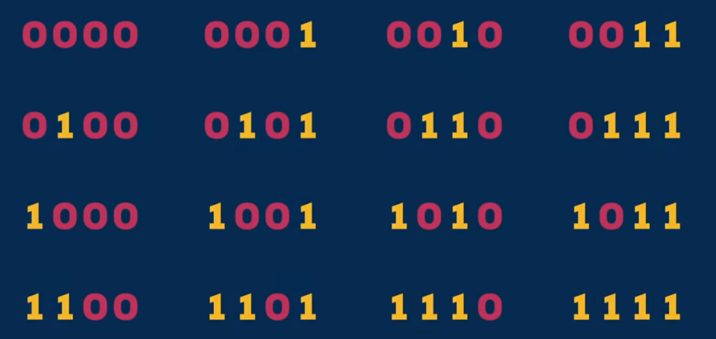
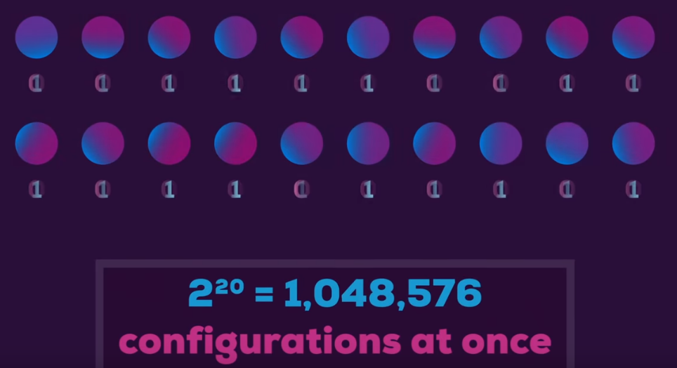
Particle decides what state to take, when being measured
Superposition

Slide 29
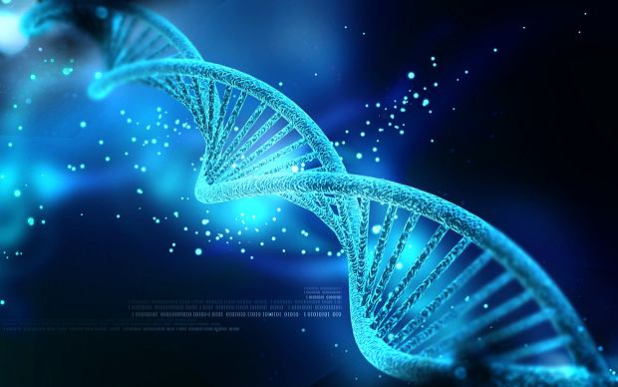
DNA Cryptography
We may talk about it another day ;)

Slide 30
Basics of Cryptography 3. Methods of breaking cyphertexts

Slide 31
"Regular Human" methods
Brute-force attack
try all combinations
Ciphertext-only attack
Discover the key by comparing cipher-texts created with the same algorythm
Known plain-text attack
Discover the key by knowing small portion of plain text
Chosen plain-text attack
Chose the plain text to discover more info about the key
Chosen cipher-text attack
Compare plain-text vs cipher-text to discover key.

Slide 32

H4ck3rm4n

Slide 33
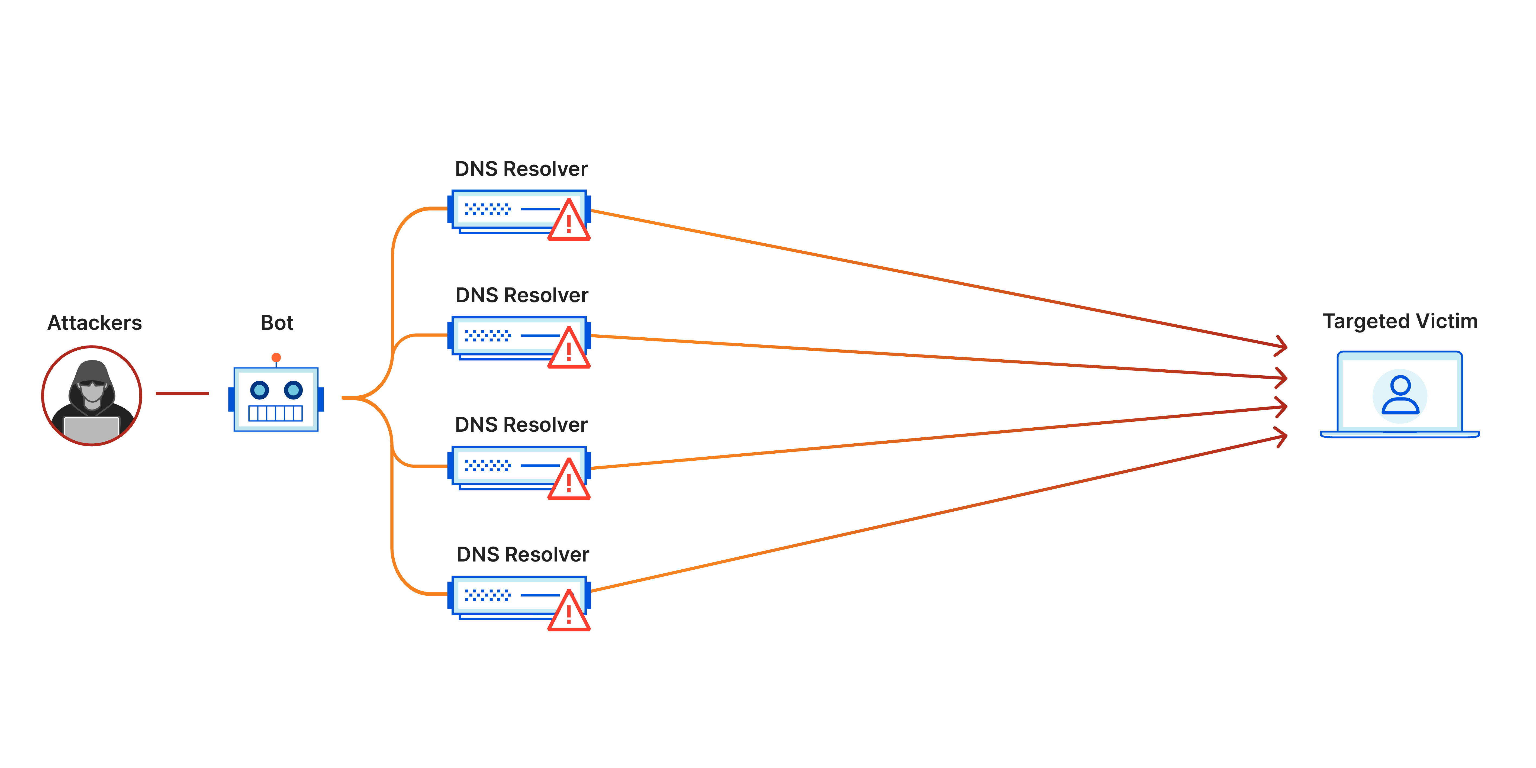
DDoS

Slide 34
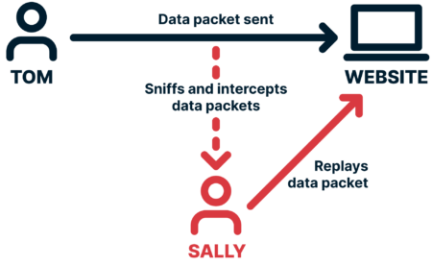
Replay Attack

Slide 35
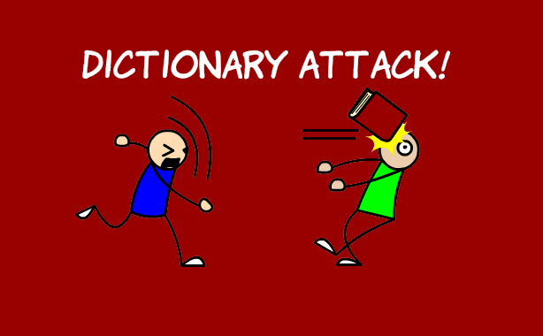

Slide 36
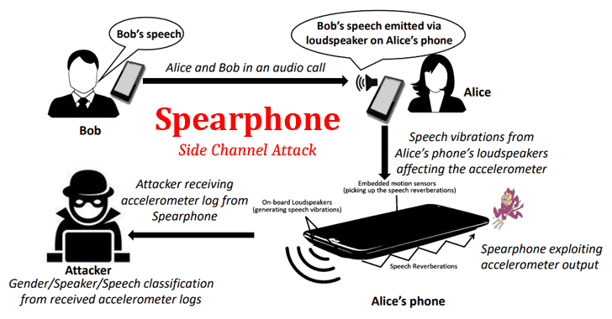
Side Channel Attack

Slide 37
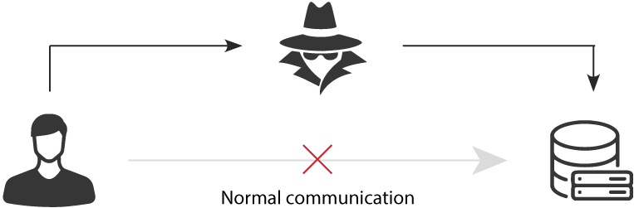
Man in the Middle Attack

Slide 38
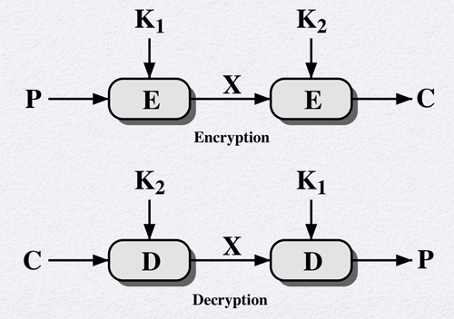

Meet in the Middle
So now to conduct Meet in the Middle attack we must ASSUME that h4ck3r somehow got to know one copy of plain_text and the final_output.

Slide 39
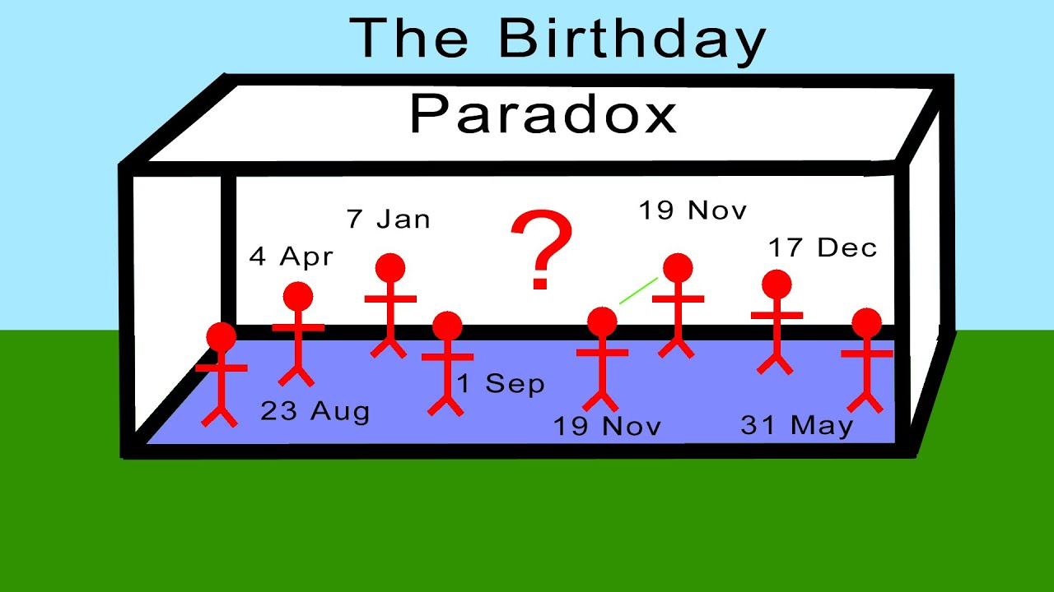
Birthday Attack
K = sqrtN
K – number of documents
N – hash length
so for 80bit hash we get:
k = sqrt2^80 => k = a lot.
But still, back in time SHA-1 was broken with this attack

Slide 40

Cleptography – back doors

Slide 41
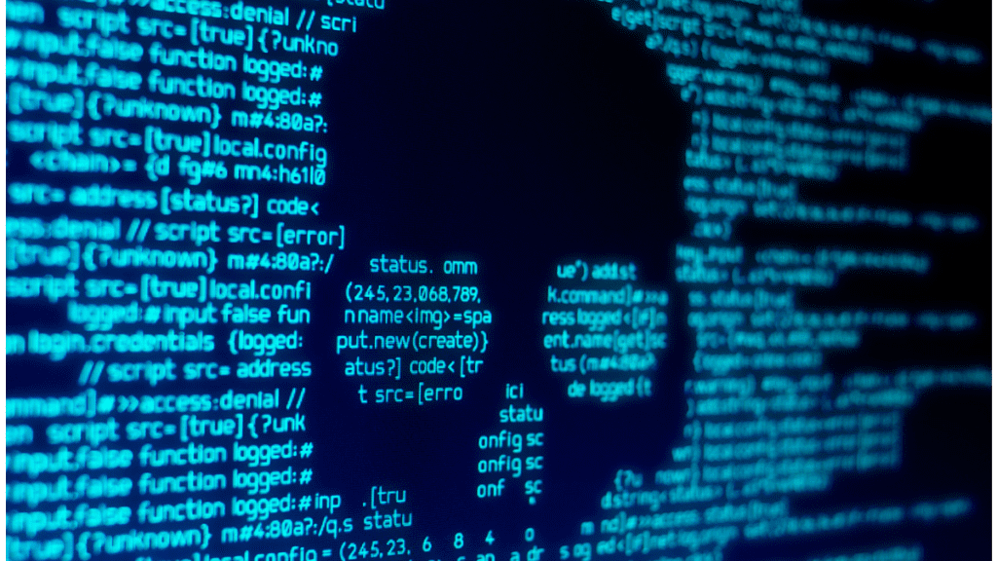
Virus

Slide 42


Slide 43
Basics of Cryptography 4. Types and Modes of Encryption

Slide 44
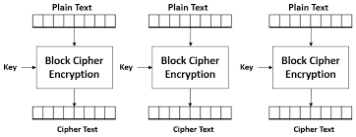
Encryption: ECB – Electronic Code Book

Slide 45
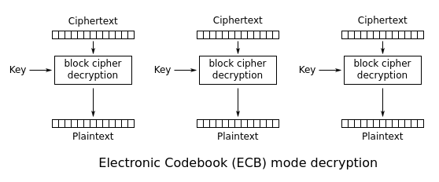
Decryption: ECB – Electronic Code Book

Slide 46
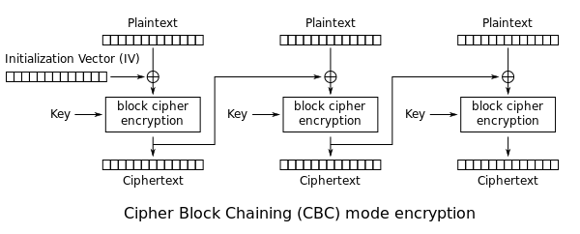
Encryption: CBC – Cipher Block Chaining

Slide 47
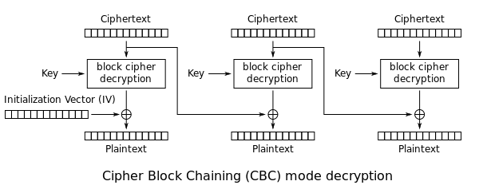
Decryption: CBC – Cipher Block Chaining

Slide 48

Encryption: CFB – Cipher Feedback

Slide 49

Decryption: CFB – Cipher Feedback

Slide 50
Encryption: CFB – Cipher Feedback

Slide 51

Decryption: OFB – Output Feedback

Slide 52


Stream Ciphers

Slide 53
Basics of Cryptography 5. Cryptographic Protocols

Slide 54


Digital Signature

Slide 55






Unforgeable Digital Signatures
Public Key
Private keys

Slide 56















Blind Signature

Slide 57


Secret Sharing
Protocol Secret Splitting
Protocol Secret Sharing

Slide 58

Proving without sharing informations

Slide 59

Subliminal Channel

Slide 60
Key Exchange Protocols
Diffie-Hellman
RSA
Elliptic Curve Cryptography (ECC)
SSL / TLS

Slide 61
Basics of Cryptography 6. Public Key Infrastructure PKI

Slide 62

Certificate Authority

Slide 63

How to get Public Key?

Slide 64

Regional Certificate Authority

Slide 65

All of this to prevent Man In the Middle

Slide 66
Certificate Lifecycle
- creation - certification - distribution - active usage - passive usage - key invalidation
Pr0 Tip: change the key. Especially if you encrypt important data and you do it often. This way no one can get enough material for cryptoanalysis.

Slide 67
Basics of Cryptography 7. Summary

Slide 68
Human is the weakest link
Good encryption + bad application = bad encryption
No encryption algorithm is 100% safe, however we consider so if:
the cost of breaking the cipher is higher than the revenue from the data
the time necessary to break the cipher is too long. Imagine you can get her facebook password 15y from now. Not worth anymore.
if the data is very important it will be good to update keys often so cryptoanalitycs can't get enough material to break it
it is impossible to crack it with currently known means (eg brutforce private keys)
Passwords:
MniS!Mcc10$ = My name is Skrillex! My concert cost 10$ = Protected against dictionary attack.
Good encryption + bad application = bad encryption

